Slide 1
Polynomial Equation Solver
By: Mariano Arce
Programming Principles II

Slide 2
Program
Is given a polynomial function of x and a range to look for roots.
Validates the function and asks for new input if invalid.
Parses the function into an array of its coefficients.
Computes and prints the roots of the equation in the given range.
Prints the nearest root if there are none inside the range.
Alerts if the function has no real roots.

Slide 3
Inputs
A string containing a polynomial function of x.
It has the form CoefficientxPower+CoefficientxPower+Numberc.
The parser traverses the string looking for x’s and c’s
When it finds one it finds the power to the right and selects the correct spot in the coefficient array (in order of powers)
Then it traverses left and finds the coefficient to input into the array.
This is then validated by another function
The boundaries of the range to look for roots
Given simply by the user and validated

Slide 4
Finding roots inside the limits
Linked list with the smallest ranges as possible
Function findLimits uses Bisection to find the lowest limits
Traverse the linked list with the valid limist
Use Bisection Method to find the roots inside the limits
If there are no roots inside the range , use Newtons Method
If Newtons Method fails, then there are no roots

Slide 5
Find Limits

Slide 6
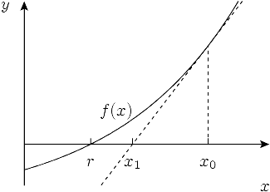
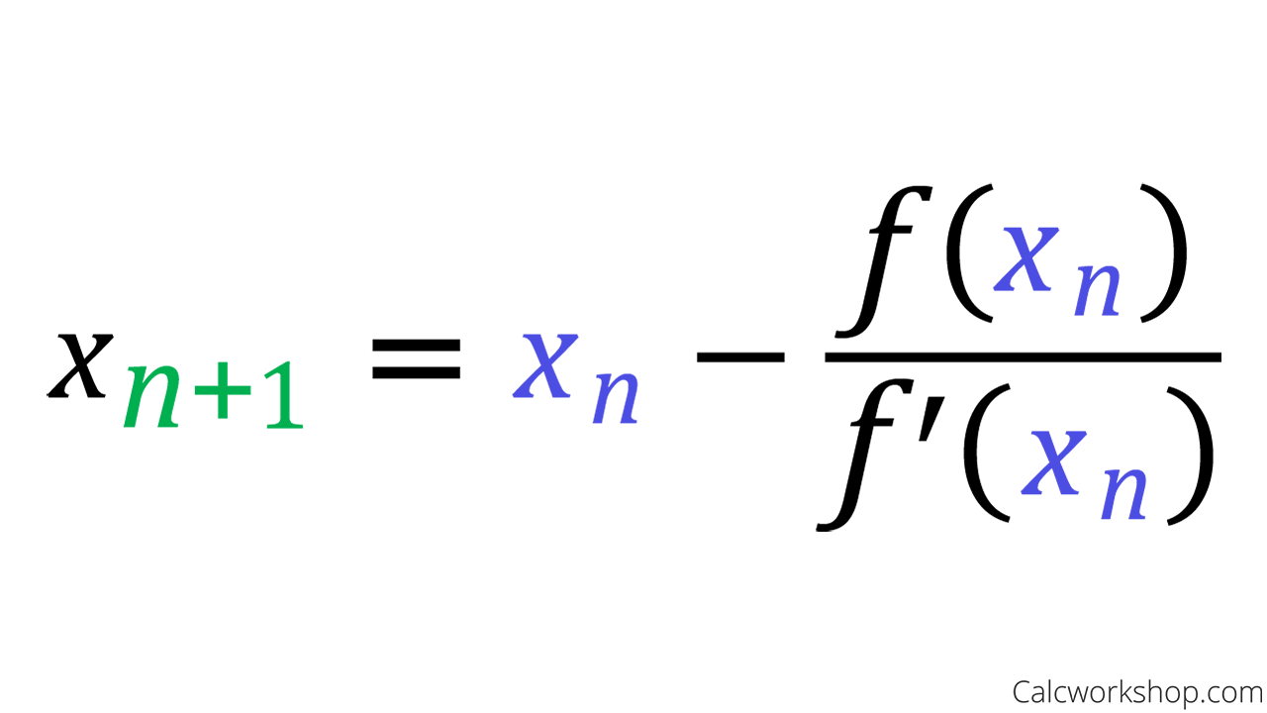
Newtons Method

Slide 7
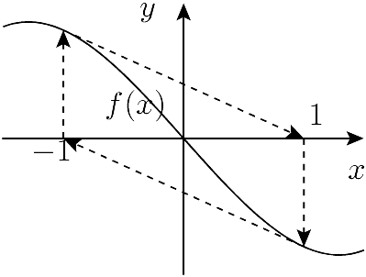
Failure

Slide 8
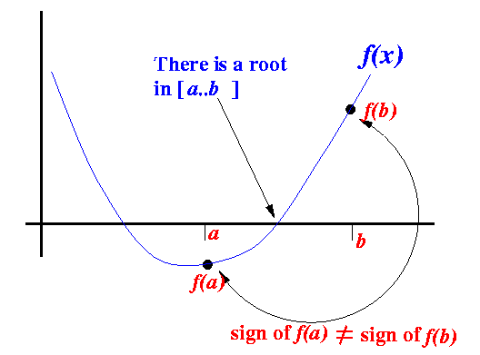
Bisection Method
Compute the midpoint
Check if the midpoint has a different sign than the lower or upper bound.
Assign the midpoint to the lower or upper bound.
Recurse until error < 0.0001

Slide 9
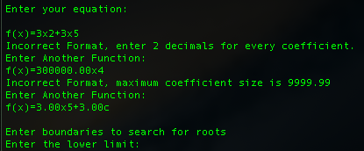
Test Results 1 - Validation

Slide 10
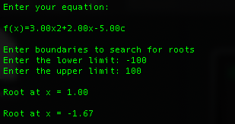
Test Results 2 – Valid Range

Slide 11
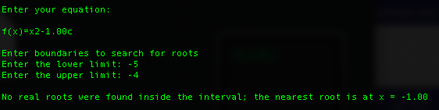
Test Results 3 – Invalid Range

Slide 12
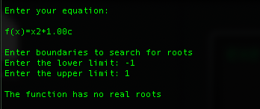
Test Results 4 – Invalid Function

